Slide 1



TVMS
TVMS
PROJECT
TEMPLE VISITORS MANAGEMENT SYSTEM

Slide 2

CONTENT
01
INTRODUCTION
02
CASE STUDY
03
PROJECT OBJECTIVES
04
METHODOLOGY
05
TOOLS & TECHNOLOGIES USED
06
OUTCOME
07
BUDGET ALLOCATION

Slide 3
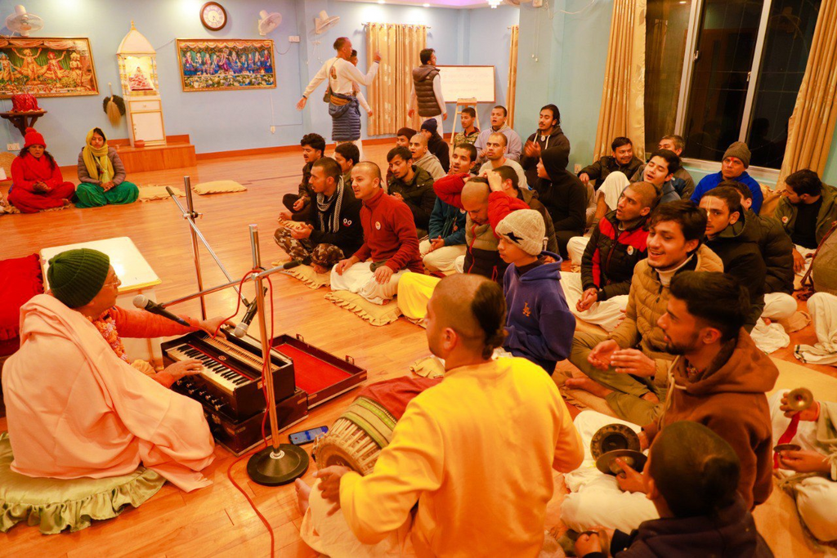

INTRO
What is TVMS?
(Temple Visitors Management System)
Digital Database to manage temple's (ISKCON) visitors records.

Slide 4

CASE STUDY
Kshetrasuvidham [1]
3ioNetra temple management system [2]
Integrated Temple Management System [3]
Chakra4temples [4]

Slide 5





GOALS AND OBJECTIVES
Objective n° 3
Objective n° 1
Objective n° 2
Web-based data manipulation
To have data for Analysis
Digital Database

Slide 6


METHODOLOGY
01
02
03
PROJECT FLOW
SOFTWARE MODEL
DIAGRAMS

Slide 7
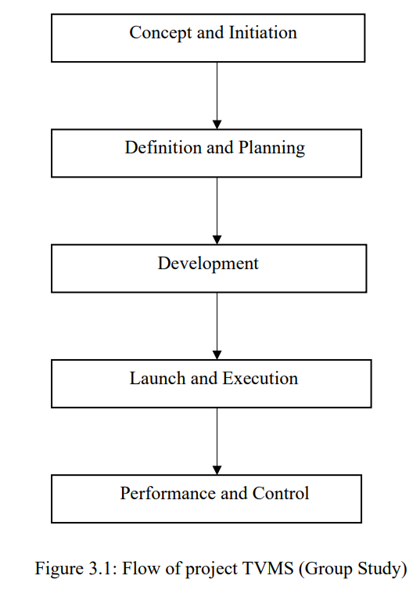
PROJECT FLOW

Slide 8
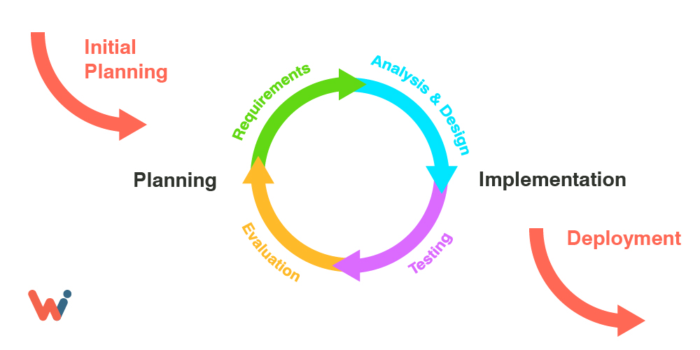
PROJECT DEVELOPMENT MODEL
ITERATIVE
Image Source: https://wishdesk.com/sites/default/files/inline-images/itterative-design-process.jpg

Slide 9
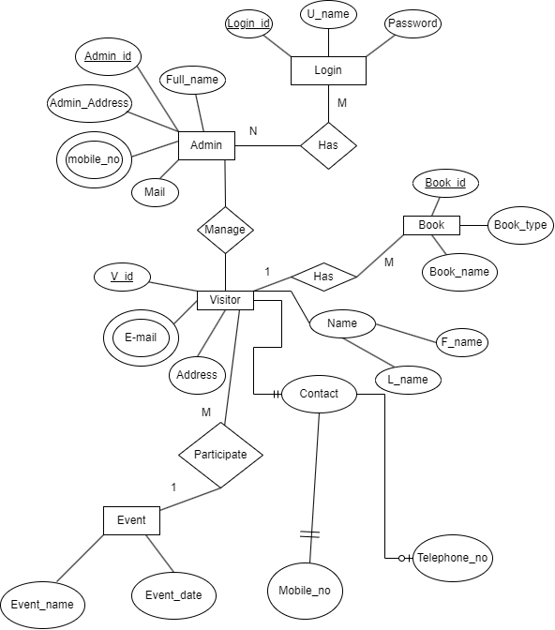
ENTITY RELATIONSHIP DIAGRAM
SOURCE: GROUP STUDY

Slide 10
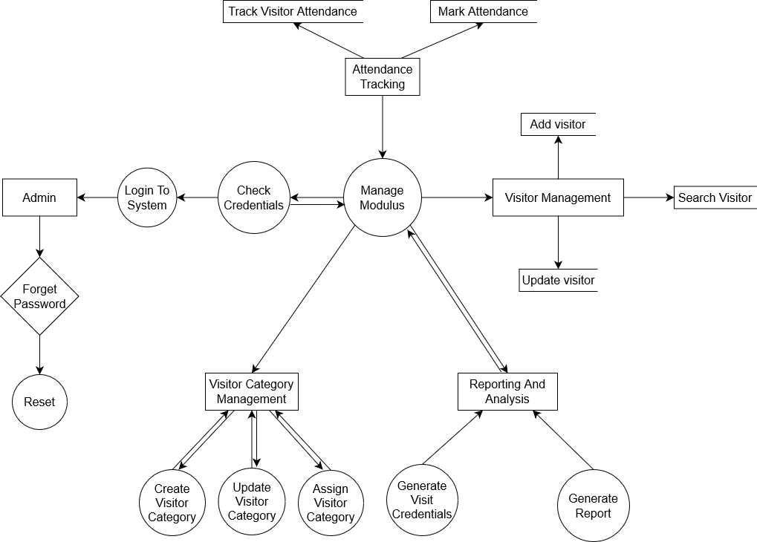
DATA FLOW DIAGRAM
SOURCE: GROUP STUDY

Slide 11
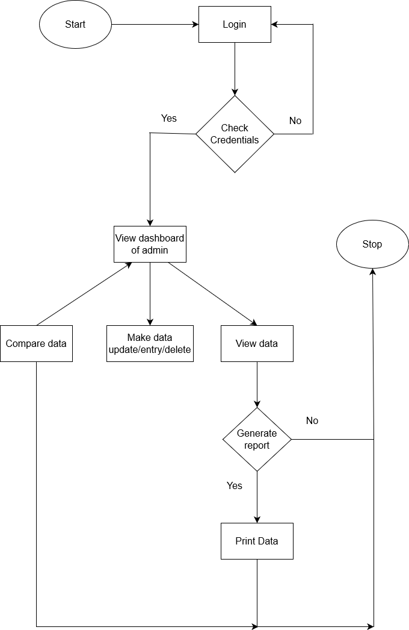
SYSTEM FLOW DIAGRAM
SOURCE: GROUP STUDY

Slide 12












TECHNOLOGIES USED

Slide 13
OUTCOMES
Web Based interface for Temple to manage visitors data.
Graphical view layer of data for data manager.
Digital database record of temple visitors.
Web-Application to promote book sales.

Slide 14
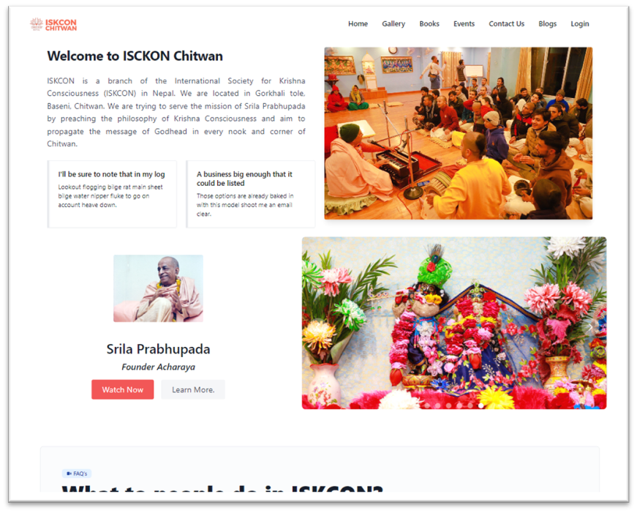
LANDING PAGE

Slide 15
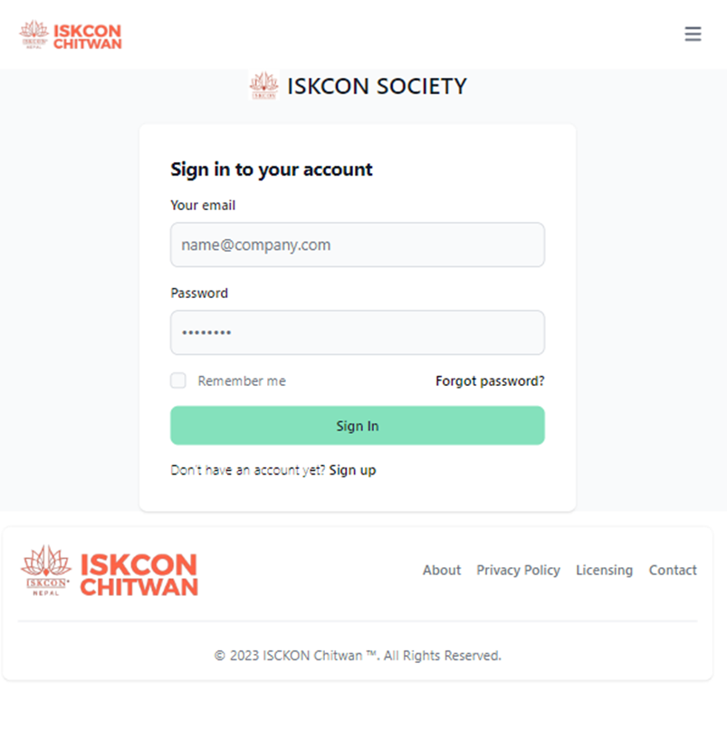
LOGIN PAGE

Slide 16
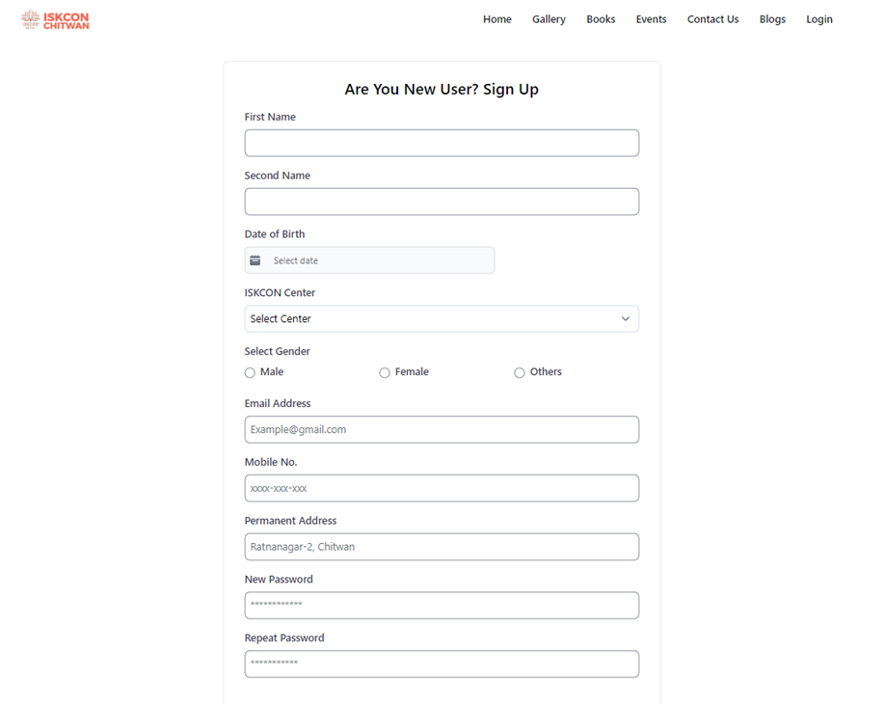
REGISTRATION PAGE

Slide 17
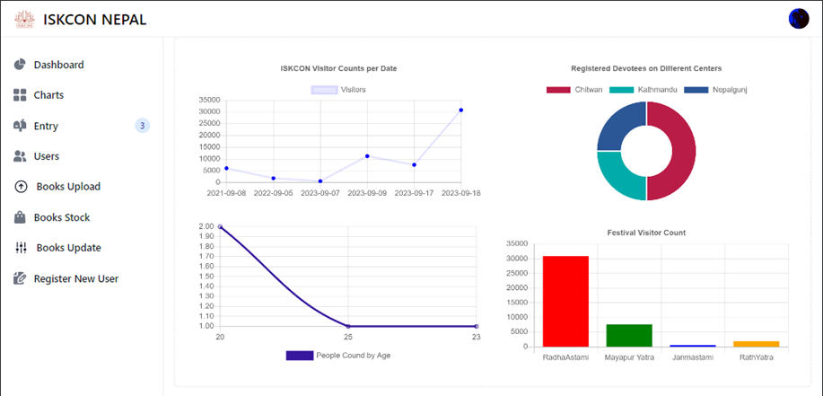
GRAPH PAGE

Slide 18
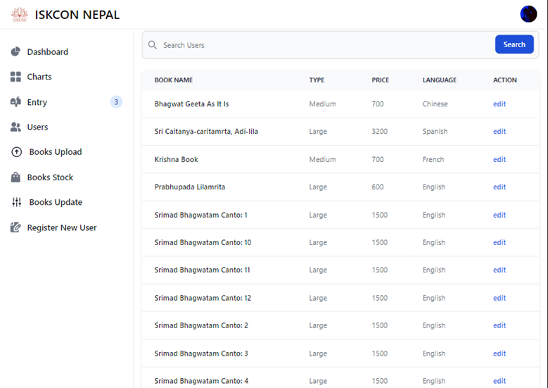
BOOKS PAGE

Slide 19
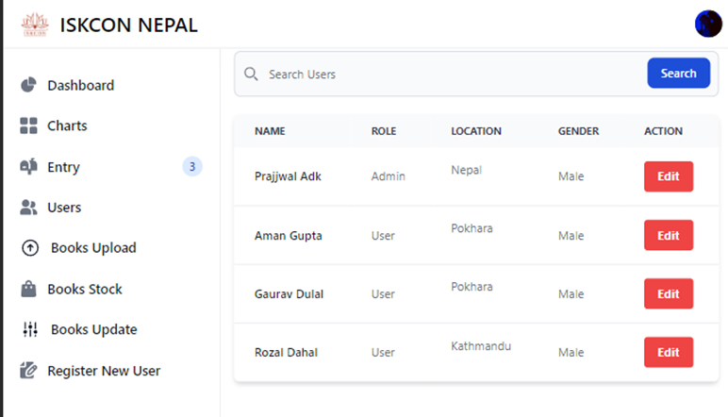
USER INFO PAGE

Slide 20
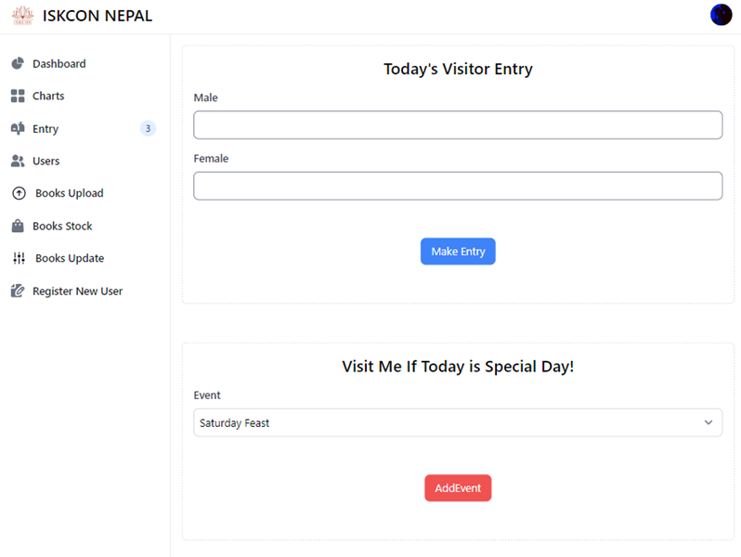
DATA ENTRY PAGE

Slide 21
BUDGET ALLOCATION
Printing
Human Resources
Internet Package
0
500
1,000
1,500
2,000

Slide 22
REFERENCES
[1] "KSHETHRASUVIDHAM," CUBIX SOFTWARE DEVELOPERS, 2023. [ONLINE]. AVAILABLE: HTTPS://KSHETHRASUVIDHAM.COM/ABOUT.HTML. [ACCESSED 22 5 2023].
[2] "K. TECHNOLOGIES", "3IONETRA," 3IONETRA, 1 2023. [ONLINE]. AVAILABLE: HTTPS://3IONETRA.IN/TEMPLE-MANAGEMENT-SOFTWARE. [ACCESSED 18 5 2023].
[3] "NATIONAL GOVERNMENT SERVICE PORTAL," [ONLINE]. AVAILABLE: HTTPS://SERVICES.INDIA.GOV.IN/SERVICE/DETAIL/INTEGRATED-TEMPLE-MANAGEMENT-SYSTEM?AND40ITMSAND41-TAMIL-NADU-1. [ACCESSED 18 5 20].
[4] "CHAKTRA4TEMPLES", 8 2021. [ONLINE]. AVAILABLE: HTTPS://WWW.CHAKRA4TEMPLES.ORG/. [ACCESSED 18 5 2023].

Slide 23
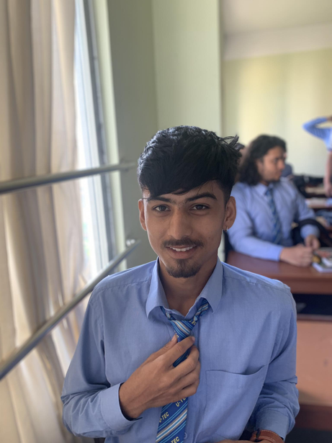
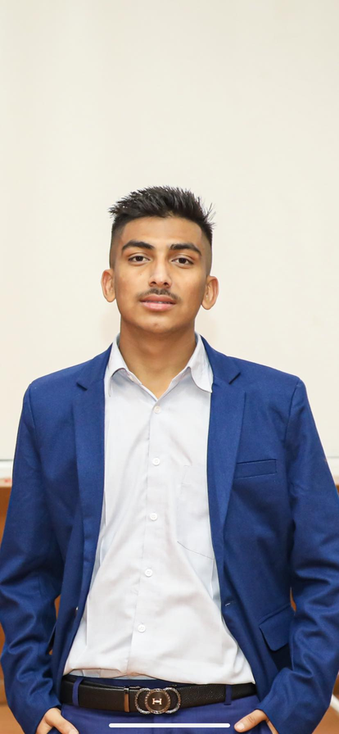
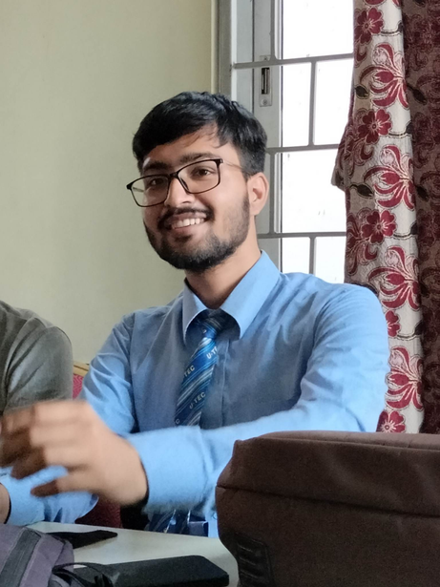

OUR TEAM
Rozal Dahal
Prajjwal Adhikari
Aman Paudel
Raj Gurung

Slide 24
THANK YOU!
ANY QUERIES?

